Slide 2
Our team are…
Experienced
Forensic
Good listeners
Strategic thinkers

Slide 3
We believe that….
Culture changes people’s lives
The best libraries are at the centre of their communities
The needs of communities should determine the library service
Successful strategies are evidence based
Consultation is about listening rather than telling

Slide 4
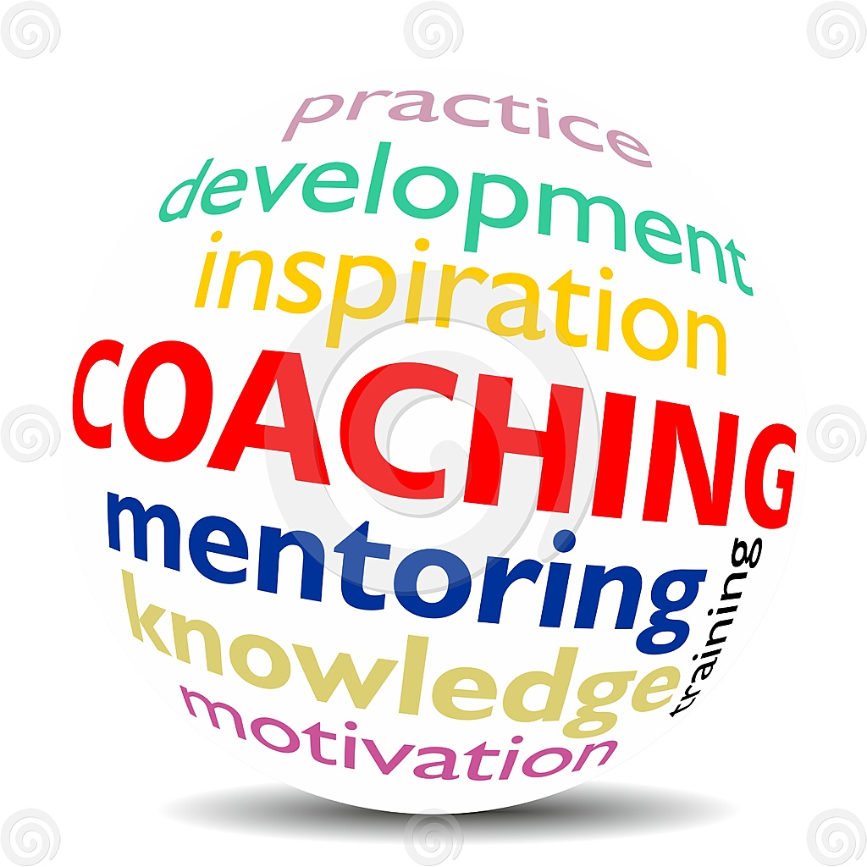
What we can do for you
Evidence based strategies and research
Comprehensive needs analysis
Consultation and engagement
Evaluations of services and projects
Financial analysis and zero based budgets
Support with alternative governance
Training and coaching
Space planning and building design

Slide 5
Sue Mckenzie
00 44 (0)7868 713786
sue.mckenzie@redquadrant.com

