Slide 1
Facebook Live toolkit

Slide 2
How to use Facebook Live
Starting a Facebook Live video differs slightly depending on whether you’re using a personal profile or your business page, and whether you are using your mobile phone or your computer.
In this guide, we’re going to show you both methods.
Before we start, here are some points to take into consideration:
Facebook will always block any copyrighted data and information, such as music and movies – please keep this in mind if you have any music playing in the background or the like.
If you are using music in the background, try to use licensed or royalty-free audio, for example, services like Shutterstock.
If carrying out a Story Time, try to ensure that the books you are using are able to be used, and that we have permission from the author and/or publisher to do so – you may be able to check with your branch manager for titles we have access to under this.
During your Facebook Live broadcast, you’ll see the number of live viewers, the names of any friends who are tuning in, and a real-time stream of comments.
Once you’ve ended your broadcast, the post will save to your profile or Page like any other video, unless you’ve selected to share it to your story only.
Live broadcasts can be up to four hours long.

Slide 3
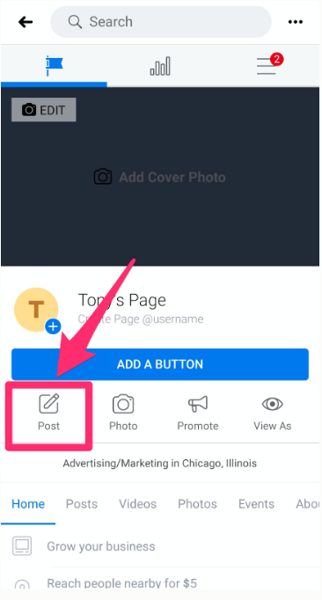
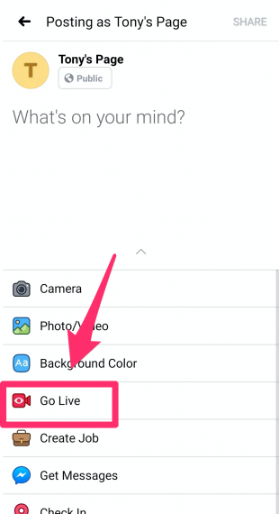
How to create a mobile Facebook Live video from your business page
1. Open the Facebook app on your mobile device.
2. Go to your business page and tap Post.
3. Tap Go Live.

Slide 4
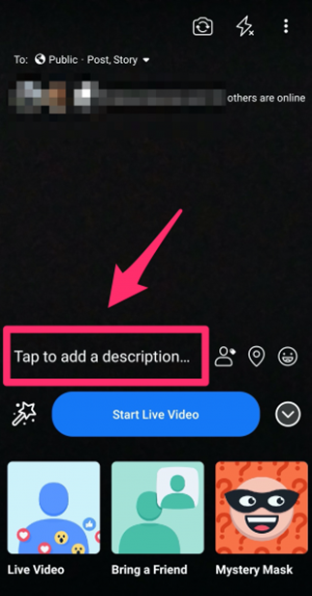
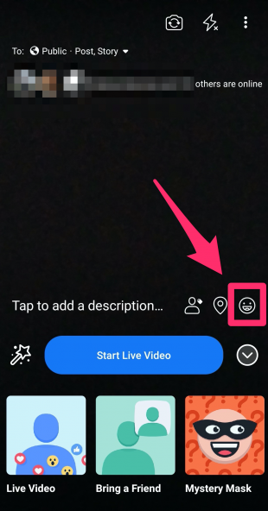
How to create a mobile Facebook Live video from your business page
4. Add a description of your video.
5. Add details: Tap the location icon to tag your location if appropriate and tap the face icon if you want to add more information about what you’re doing.

Slide 5
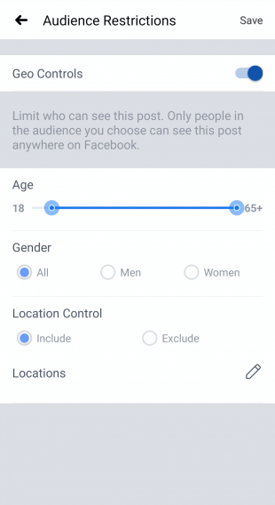
How to create a mobile Facebook Live video from your business page
6. Tap the three dots icon on the top right, then tap Audience Restrictions to select the audience for your video.
It is important to select the right audience for your live feed – for example, if doing a story time, you want to ensure you’re focusing on your audience being families and/or parents.

Slide 6
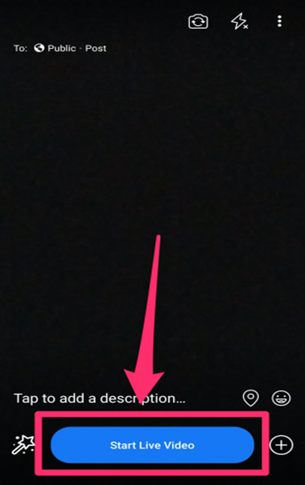
How to create a mobile Facebook Live video from your business page
8. Go back and tap Start Live Video.
And you’re all set! Your live Facebook feed is up and ready to go!

Slide 7
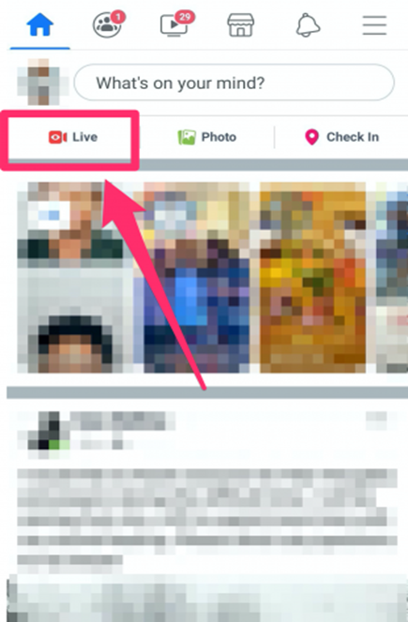
How to create a mobile Facebook Live video from your personal profile
1. Open the Facebook app on your mobile device
2. From your newsfeed, tap Live at the top of the screen. Alternately, you can tap What’s on your mind? and then tap Go Live.

Slide 8
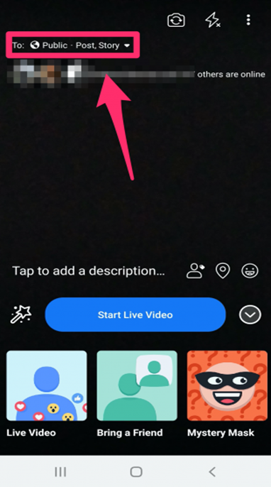
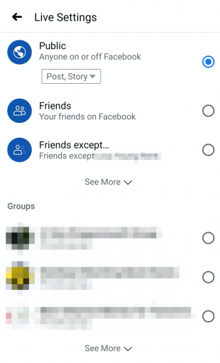
How to create a mobile Facebook Live video from your personal profile
3. Tap the To: field to choose whether to make your video public, visible only to friends, visible in a group, or visible to only a custom list.
4. From the same screen, choose whether to share your live video as a post, or only to your Facebook story.
Note: If you choose to share it only to your Story, the video will only be available while you are broadcasting - it will not be saved to your profile.

Slide 9
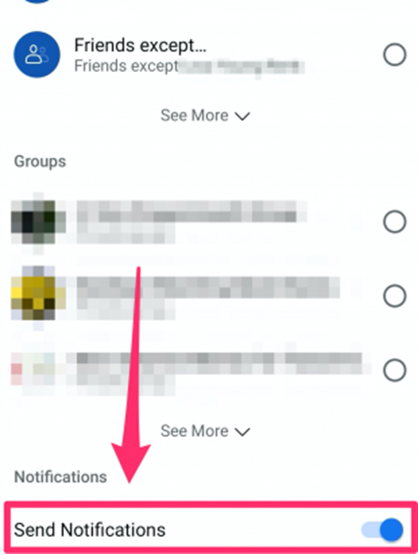
How to create a mobile Facebook Live video from your personal profile
5. Scroll down to Notifications and make sure the Send Notifications toggle is switched on to notify friends and followers when you go live.
This step is very important as it helps to reach out to your potential audience, and ensures your live feed has viewers.

Slide 10
How to create a mobile Facebook Live video from your personal profile
6. Add a description of your video.
You should try to make this catching yet descriptive – avoid a lot of jargon and a lot of writing, focusing more on what you’re actually doing as a summary, e.g.: ‘Online Rhyme & Story Time’.

Slide 11
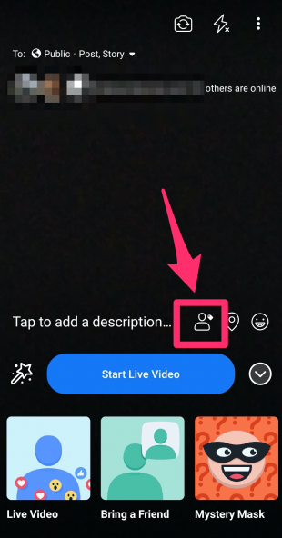
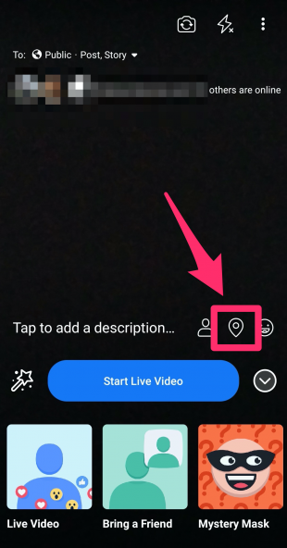
How to create a mobile Facebook Live video from your personal profile
7. Now add details:
Tap the person icon to tag anyone who appears in your video with you.
Tap the location icon to add your location if appropriate.
Tap the face icon to add more information about how you’re feeling or what activity you’re showcasing in your video.

Slide 12
How to create a mobile Facebook Live video from your personal profile
8. Tap Start Live Video to broadcast by yourself or Bring a Friend to broadcast with another person in a different location.
9. Tap Start Live Video.

Slide 13
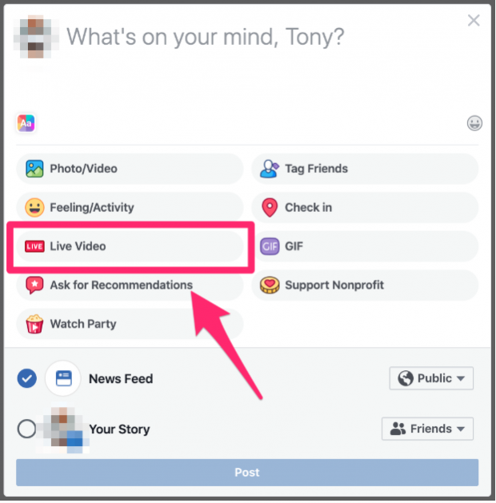
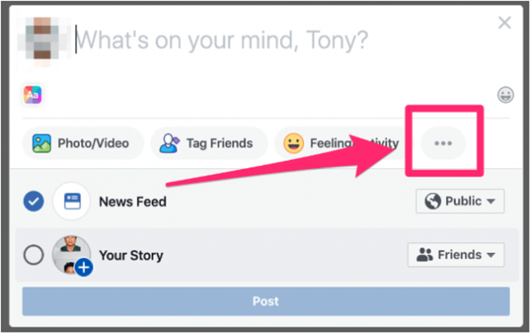
How to create a Facebook Live video on your computer
1. From the Create post box on your news feed, click the three dots.
2. Then click on Live Video.

Slide 14
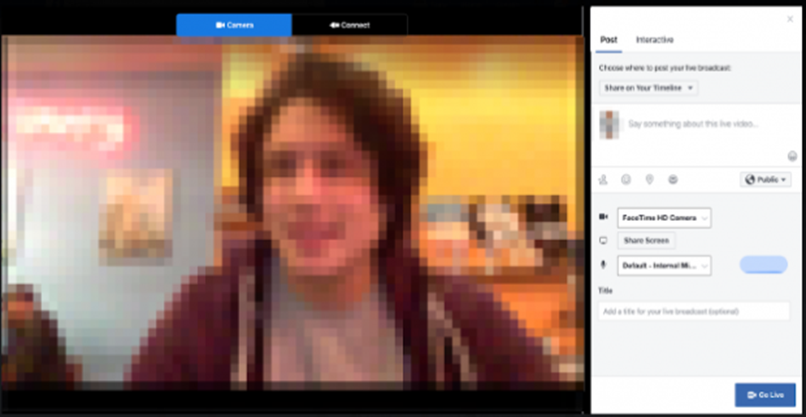
How to create a Facebook Live video on your computer
3. Click Camera to use your computer’s built-in webcam.
4. Choose where your video will appear and add your description.
5. Add a title for your video.
6. Click Go Live.

