Slide 1
Libraries Connected Awards 2021

Slide 2
Libraries Connected is launching the inaugural Libraries Connected Awards 2021 to celebrate the achievements of people working in libraries, acknowledging excellence and showcasing good practice. The awards will also show those outside the sector the range of work library staff coordinate and deliver, impacting all parts of their communities.

Slide 3
Award categories
The awards are linked to the Universal Library Offers and Promises, and will be judged by the leaders of these areas of work nationally.
The awards will be made in six categories:
Culture and Creativity
Health and Wellbeing
Information and Digital
Reading
Children Promise
Visual and Print Impaired People’s Promise

Slide 4
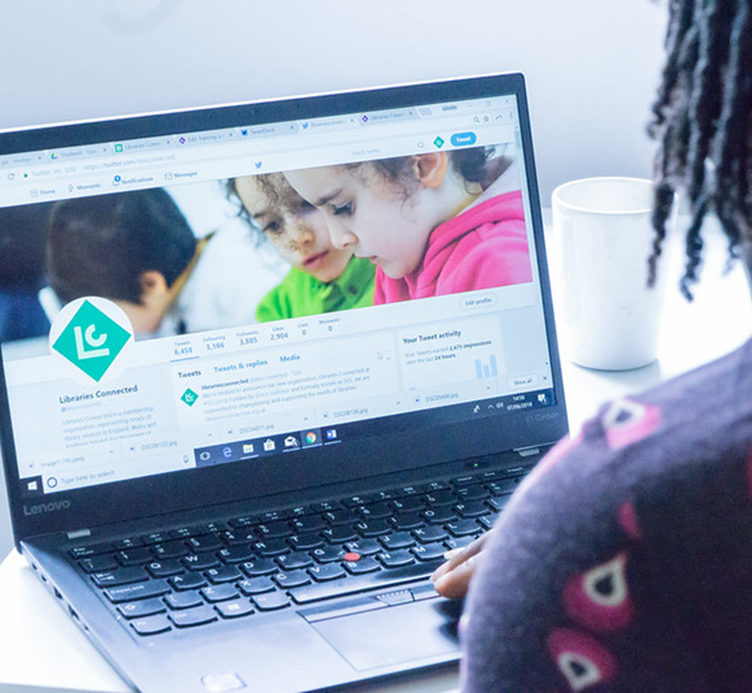
Nominations
Any individual or team below Head of Service level, working in public libraries can be nominated.
Applications are welcomed from individuals, on their own behalf or on behalf of others, and from partner organisations.
The most important part of the online nomination form is the written statement explaining why the nominee should be considered for an award, this should be no more than 500 words.
The deadline for nominations is 6pm on Friday 30 July.

Slide 5
Judging criteria
When judging these awards, we will be assessing whether the nominees have:
1. Had a clear impact on:
Improving their library service
Increasing engagement with library users
Understanding and meeting the needs of their local community
2. Gone beyond what is expected by:
Developing new services
Improving existing services
Responding to a particular local need
3. Demonstrated innovation through:
Services delivered
Methods of delivery
Approaches to funding
Working in partnership
4. Widened the reach of the library by:
Improving access for people with health conditions or impairments
Diversifying the library offer, making it more inclusive and welcoming to all sections of the community
We do not expect nominations to meet all these criteria, however, we would expect successful nominations to meet at least one of the criteria in each category.

Slide 6
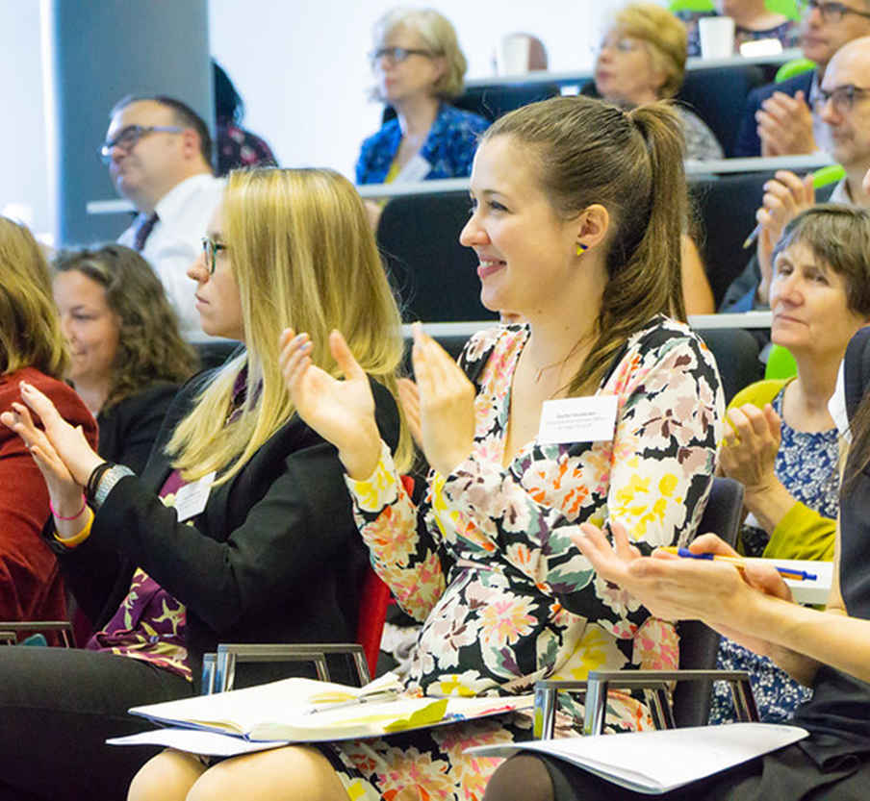
The awards
The judging will take place over the summer and we expect to notify the winners by mid-September.
The winner in each category will:
Have their story featured on the Libraries Connected website
Receive a free place* at the Libraries Connected Annual Seminar in October (including accommodation and travel) where the awards will be presented.
*If a team wins, they will need to choose one person to represent them at the seminar

Slide 7
For further information please visit www.librariesconnected.org.uk or email info@librariesconnected.org.uk

